Slide 1
human Biology Sixteenth Edition
Sylvia S. Mader
Michael Windelspecht
Chapter 1 Lecture Outline
©2020 McGraw-Hill Education. All rights reserved. Authorized only for instructor use in the classroom. No reproduction or further distribution permitted without the prior written consent of McGraw-Hill Education.

Slide 2
What are the defining traits of life?

Slide 3
What are the defining traits of life?
GO SHARE
Growth
Organization
Response to Stimuli
Homeostasis
Adaptations to environment
Reproduction
Energy Transformations

Slide 4
Exploring Life and Science: The Characteristics of Life
Learning Outcomes:
Explain the basic characteristics common to all living organisms.
Describe the levels of organization of life.
Explain why the study of evolution is important in understanding life.

Slide 5
Living things Grow
Growth—increase in size and in the number of cells.
Development—all changes that occur from fertilization until death.
Includes changes occurring in childhood, adolescence, and adulthood; also repair after injury.

Slide 6
Life is Organized 1
What are the levels of organization found within living things, from the smallest bacterial cell through the homo sapien?
What terms describe interactions of individuals, and their associations with their environments?

Slide 7
Life is Organized 1
Levels of biological organization:
Atoms join together to form molecules.
Cell—smallest structural and functional unit of an organism.
Some organisms are single-celled; some, like humans, are multicellular (composed of many cells).
Tissue—group of similar cells that perform a particular function.

Slide 8
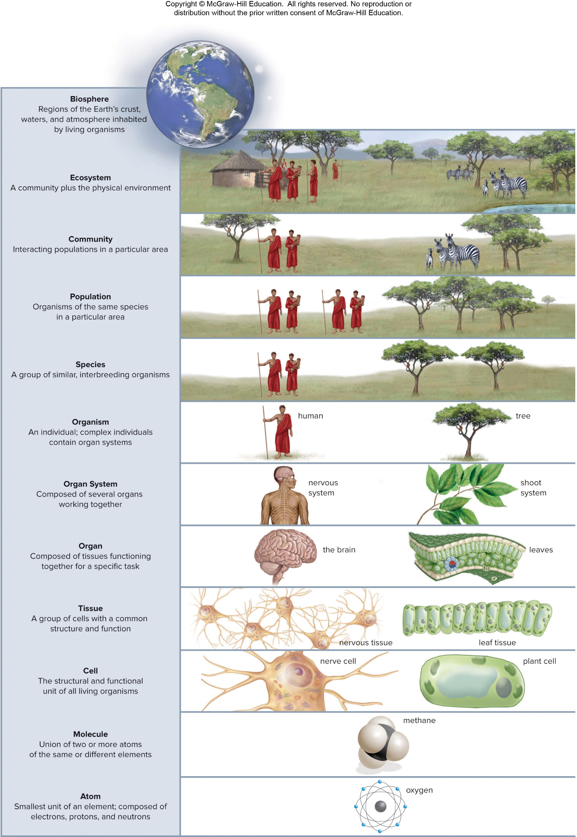
Levels of Biological Organization (Figure 1.2)
Access the text alternative for these images

Slide 9
Living Organisms Respond to Stimuli
Homeostasis would be impossible to maintain without the ability to respond to stimuli.
That is, external stimuli: remove one’s hand from a hot stove.
That is, internal stimuli: adjustments to blood pressure in response to values outside of normal.

Slide 10
Living Organisms Maintain an Internal Environment
Homeostasis—a constant internal environment.
Most organ systems strive to maintain homeostasis.
That is, body temperature is maintained within a narrow range of values.

Slide 11
Organisms Have an Evolutionary History
Evolution—how a population changes over time.
Natural selection—the process by which evolution occurs.
When a new variation occurs that allows organisms to capture more resources, those individuals have more offspring.
Adaptation—over time, population has more individuals with this advantageous variation.

Slide 12
Living Organisms Reproduce and Develop 1
When organisms reproduce, they pass on their genetic information to the next generation.
DNA (deoxyribonucleic acid)—the genetic information of all life.
Contains hereditary information that directs the structure and function of all cells.
Contains genes—short segments that specify traits
Mutations—variations in genes.
Can be beneficial and make organism better suited for its environment (this is the basis for evolution).

Slide 13
Life Requires Materials and Energy Transformations 1
Energy—the capacity to do work.
Humans acquire materials and energy by eating.
Food provides nutrients, which are used for building blocks and energy.

Slide 14
Life Requires Materials and Energy 2
Metabolism—all of the chemical reactions that occur within cells.
The ultimate source of energy for life on Earth is the sun.
Photosynthesis—used by plants, algae, and some bacteria.
Harvests energy from the sun and converts it to chemical energy.
Produces sugars, which serve as the basis for the food chain for other organisms.

Slide 15
Check Your Progress 1.1
List the basic characteristics of life.
Summarize the levels of biological organization.
Explain the relationship between adaptations and evolutionary change.

Slide 16
Classification of Living Things
Learning Outcomes:
Summarize the place of humans in the overall classification of living organisms.
Understand that humans have a cultural heritage.
Describe the relationship between humans and the biosphere.

Slide 17
Classification
All life is classified into one of three domains: What are these domains?
What are examples of each domain?
What are defining characteristics?

Slide 18
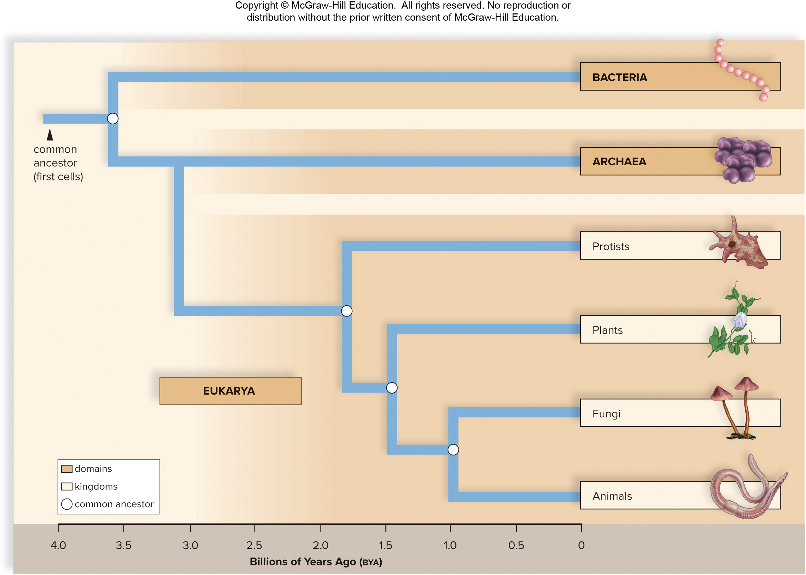
The Evolutionary Relationships of the Three Domains of Life (Figure 1.5)
Access the text alternative for these images

Slide 19
Humans Are Related to Other Animals 3
The domain Eukarya is divided into four kingdoms:
Plants (Plantae).
Fungi (Fungi).
Animals (Animalia).
Protists (Protista).

Slide 20
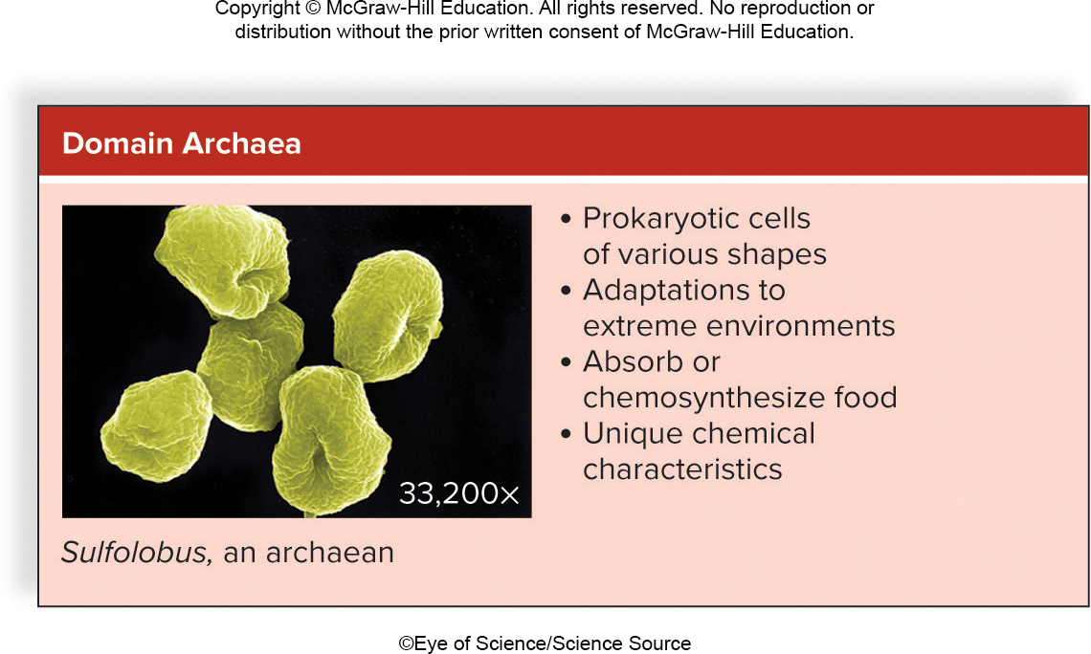
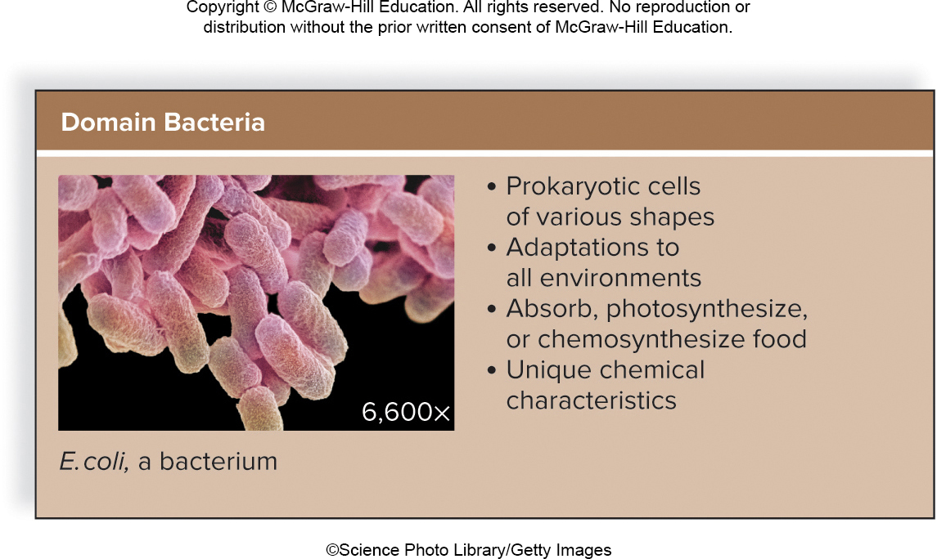
The Classification of Life (Figure 1.6, Archaea and Bacteria)
Access the text alternative for these images
(Left image): ©Eye of Science/Science Source; (Right image): ©Science Photo Library/Getty Images

Slide 21
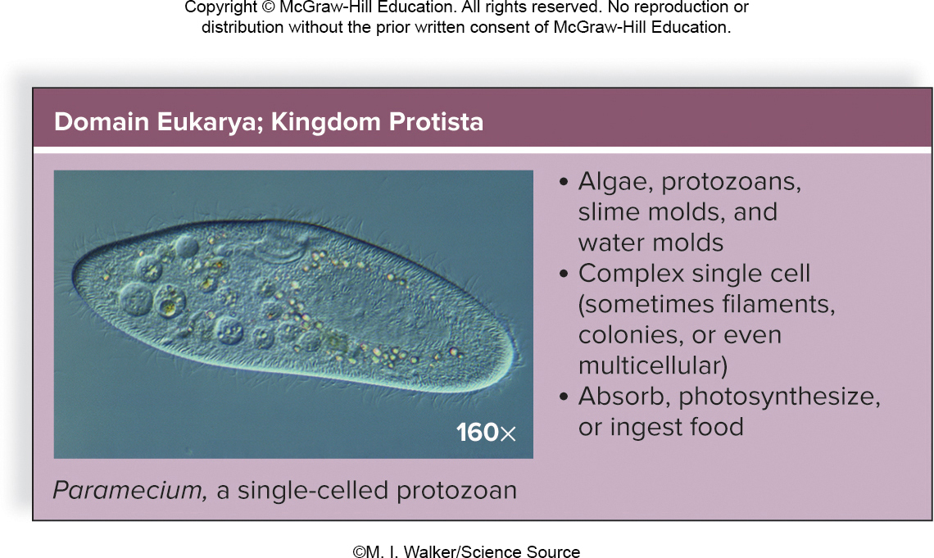
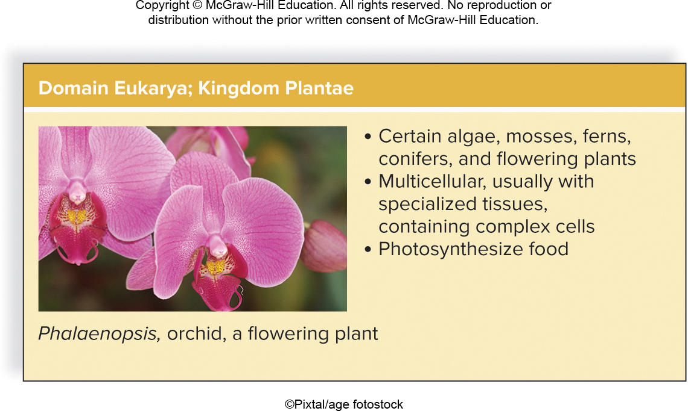
The Classification of Life (Figure 1.6, Protista and Plantae)
Access the text alternative for these images
(Left image): ©M. I. Walker/Science Source; (Right image): ©Pixtal/age fotostock

Slide 22
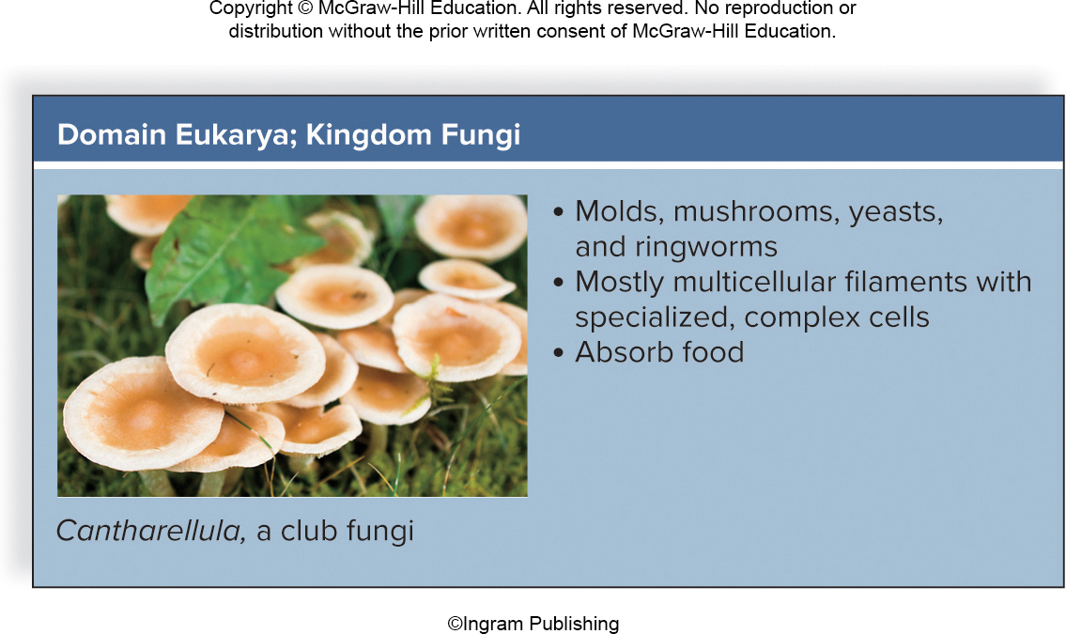
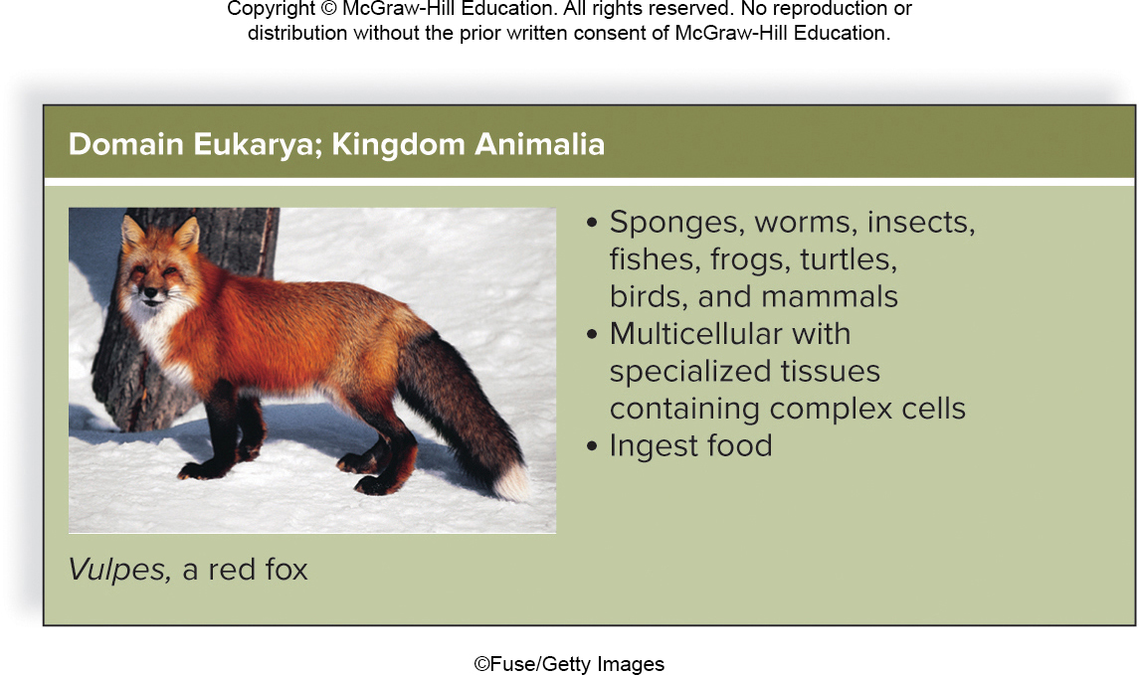
The Classification of Life (Figure 1.6, Fungi and Animalia)
Access the text alternative for these images
(Left image): ©Ingram Publishing; (Right image): ©Fuse/Getty Images

Slide 23
Kingdom Animalia
Most organisms in kingdom Animalia are invertebrates.
That is, earthworms, insects, mollusks.
Vertebrates.
Have a nerve cord protected by a vertebral column.
That is, fish, reptiles, amphibians and birds.
Vertebrates with hair or fur and mammary glands are called mammals.
That is, humans, raccoons, seals.

Slide 24
Humans
Humans are most closely related to apes, but are distinguished from apes by:
Highly developed brains.
Completely upright stance.
Creative language skills.
Ability to use a wide variety of tools.
Humans and apes have a common ancestor.

Slide 25
Humans Have a Cultural Heritage
Culture—activities and items passed down from one generation to the next.
Beliefs, values, and skills.
Arts and sciences.

Slide 26
Humans Are Members of the Biosphere
The biosphere spans the surface of the Earth, into the atmosphere and down into the soil and seas.

Slide 27
Check Your Progress 1.2
Define the term biosphere.
Define culture.
Explain why humans belong to the domain Eukarya and kingdom Animalia.

Slide 28
Science as a Process 1
Learning outcomes:
Describe the general process of the scientific method.
Distinguish between a control group and an experimental group in a scientific test.
Recognize the importance of scientific journals in the reporting of scientific information.
Interpret information that is presented in a scientific graph.
Recognize the importance of statistical analysis to the study of science.

Slide 29
Science as a Process 2
Science—a way of knowing about the natural world.
Scientists should be objective (factual), not subjective (involves judgment).
The scientific process uses the scientific method.
A standard series of steps.

Slide 30
Start with an Observation
Observation is a formal way of watching the natural world.
Made with.
the senses (sight, smell).
the help of instruments like microscopes.
through research.

Slide 31
Develop a Hypothesis
A hypothesis is a possible explanation for the observation of a natural event.
Inductive reasoning—when someone uses creative thinking to combine facts into a cohesive whole.
Scientists make a testable prediction based on a hypothesis.

Slide 32
Test a Hypothesis
Scientists use deductive reasoning to test the hypothesis (“if, then” logic).
Experiments are designed with experimental variables and responding (dependent) variables.
Test groups and a control groups are also used.
Model organisms (like mice) are also used.

Slide 33
Collecting and Analyzing the Data 1
Results are derived from experiments.
Results, in the form of data, may be presented in a variety of formats.
Graphs are useful tools to summarize data.
Line graphs, bar graphs.

Slide 34
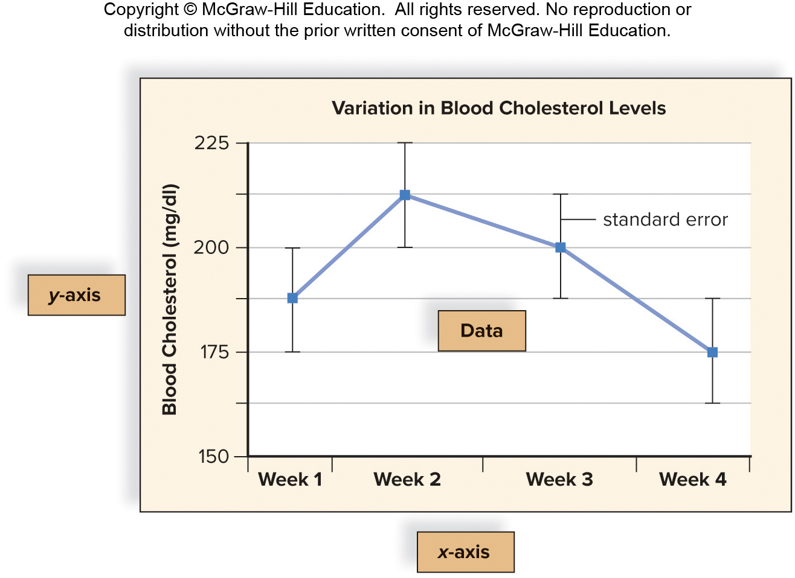
The Presentation of Scientific Data (Figure 1.9)
Access the text alternative for these images

Slide 35
Collecting and Analyzing the Data 2
Statistics are used to interpret data.
Statistical data include a standard error (standard deviation) to show how uncertain a value is.
Statistical significance is determined to evaluate the probability that the results are due to chance or some other experimental variable.
Studies can be published in Scientific publications.

Slide 36
Develop a Conclusion
Scientists analyze the data in order to reach a conclusion about whether a hypothesis is supported or not.
The conclusion of one experiment can lead to the hypothesis for another experiment.

Slide 37
Scientific Theory
Scientific theory—accepted explanations for how the world works.
That is, cell theory—all organisms are made of cells.
Law, or principle—accepted by an overwhelming majority of scientists.
That is, evolution.

Slide 38
An Example of a Controlled Study
Hypothesis: antibiotic B is better than the currently used antibiotic A.
Control group: subjects with ulcers receive a placebo (a pill that contains no medication).
The two test groups each receive one of the antibiotics.
Double-blind study—neither the doctors nor the patients know which group they are in.
Conclusion—antibiotic B had better results.

Slide 39
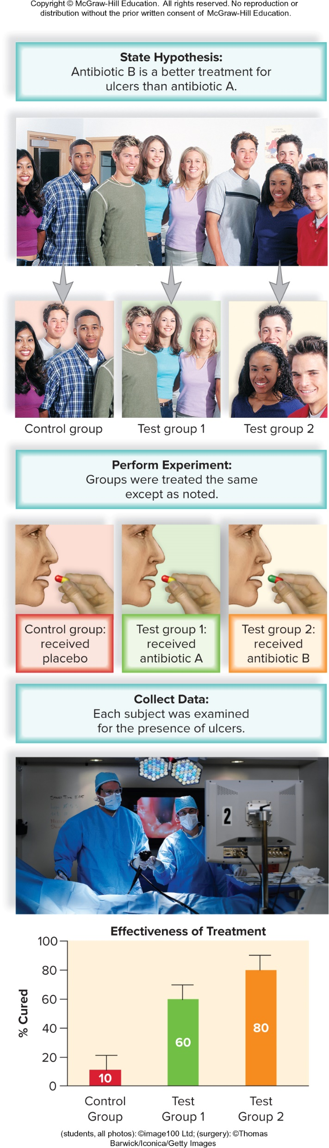
A Controlled Laboratory Experiment to Test the Effectiveness of a Medication in Humans (Figure 1.10)
Access the text alternative for these images

Slide 40
Check Your Progress 1.3
Describe each step of the scientific method.
Explain why a controlled study is an important part of the experimental design.
List a few pros and cons of using a scientific journal versus other sources of information.
Summarize how the use of graphs and statistics aids in data analysis.

Slide 41
Challenges Facing Science 1
Learning Outcomes:
Distinguish between science and technology.
Summarize some of the major challenges facing science.

Slide 42
Biodiversity and Habitat Loss
Technology—the application of scientific knowledge to human interests.
Biodiversity—the total number and relative abundance of species, the variability of their genes, and the different ecosystems in which they live.
Extinction—the death of a species.
Many biologists are alarmed at the current high rate of extinction.

Slide 43
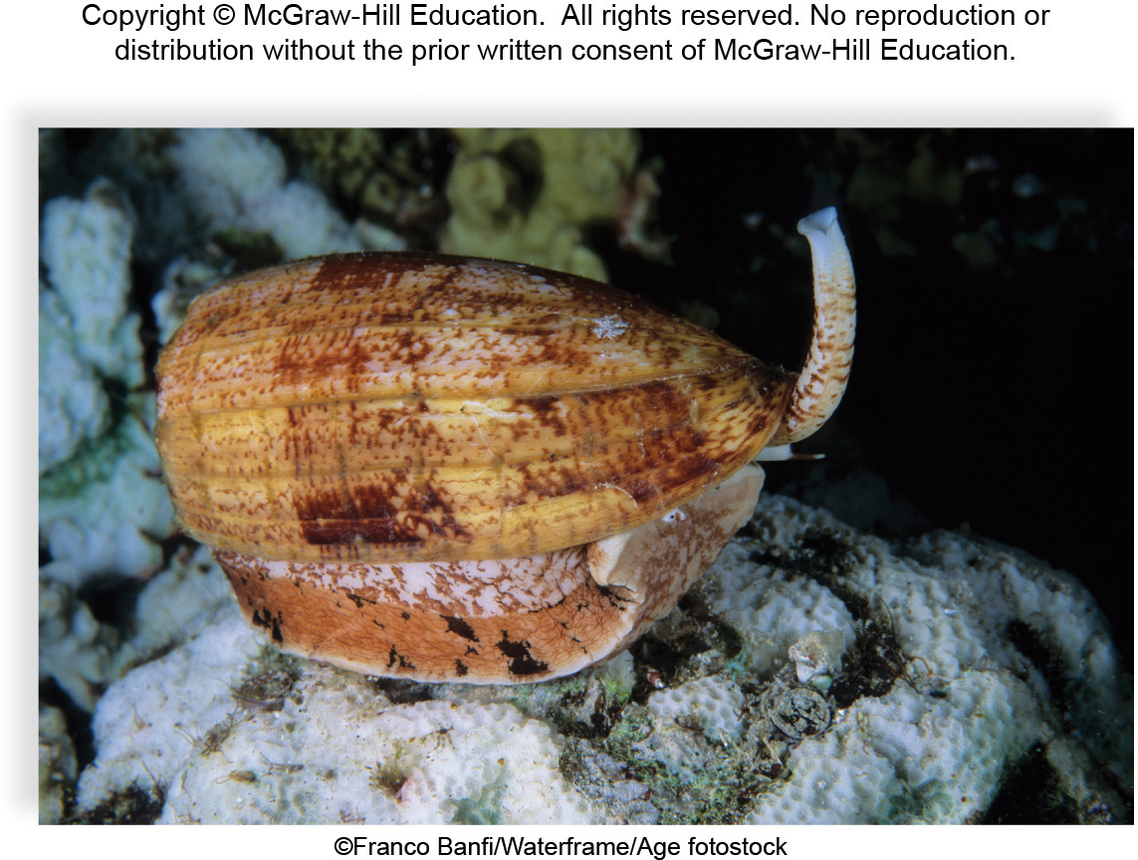
Preserving Biodiversity (Figure 1.11)
©Franco Banfi/Waterframe/Age fotostock

Slide 44
Emerging and Reemerging Diseases
Emerging diseases—relatively new.
Examples: avian influenza (H5N1, H7N9), swine flu (H1N1), severe acute respiratory syndrome (SARS), and Middle East respiratory syndrome (MERS).
Reemerging diseases—known for some time and considered low risk but for occasional outbreaks. Example: Ebola.
Some come from new or increased exposure to certain animals.
Some come from globalization (they spread more easily).
Some come when disease vectors mutate and change hosts.

Slide 45
Climate Change
Climate change—changes in the normal cycles of the Earth’s climate due to human activity.
imbalance in chemical cycling of carbon.
Global warming—an increase in temperature due to increasing CO₂ levels in the atmosphere.
Scientific consensus: climate change and global warming are causing significant changes in Earth’s ecosystems.

Slide 46
Check Your Progress 1.4
Explain how a new technology differs from a scientific discovery.
Explain why the conservation of biodiversity is important to human society.
Summarize how emerging diseases and climate change have the potential to influence the entire human population.

Slide 47
Accessibility Content: Text Alternatives for Images

Slide 48
Levels of Biological Organization (Figure 1.2) Text Alternative
Atom: Smallest unit of an element, composed of electrons, protons, and neutrons. Molecule: Union of 2 or more atoms of the same or different elements. Cell: The structural and functional unit of all living organisms. Tissue: A group of cells with a common structure and function. Organ: Composed of tissues functioning together for a specific task. Organ system: Composed of several organs working together. Organism: An individual; complex individuals contain organ systems. Species: A group of similar, interbreeding organisms. Population: Organisms of the same species in a particular area. Community: Interacting populations in a particular area. Ecosystem: A community plus the physical environment. Biosphere: Regions of the Earth's crust, waters, and atmosphere inhabited by living organisms.
Return to slide containing original image

Slide 49
The Evolutionary Relationships of the Three Domains of Life (Figure 1.5) Text Alternative
Archaea and Bacteria diverged over 3 point 5 billion years ago. Eukarya diverged from Archaea over 3 billion years ago. Within the Domain Eukarya, protists diverged 1 point 8 billion years ago, plants diverged 1 point 5 billion years ago, and fungi and animals diverged 1 billion years ago. The Animal and Fungi kingdoms are the most closely related kingdoms within the Domain Eukarya.​
Return to slide containing original image

Slide 50
The Classification of Life (Figure 1.6, Archaea and Bacteria) Text Alternative
Domain Archaea Includes prokaryotic cells of various shapes with adaptations to extreme environments. Archaea absorb or chemosynthesize food and have unique chemical characteristics. Domain Bacteria includes prokaryotic cells of various shapes with adaptations to all environments. Bacteria absorb, photosynthesize, or chemosynthesize food and have unique chemical characteristics.
Return to slide containing original image

Slide 51
The Classification of Life (Figure 1.6, Protista and Plantae) Text Alternative
Domain Eukarya; Kingdom Protista includes algae, protozoans, slime molds, and water molds. It consists of complex single-celled organisms that can be filaments, colonies or even multicellular. Protists absorb, photosynthesize, or ingest their food. Domain Eukarya; Kingdom Plantae includes certain algae, mosses, ferns, conifers, and flowering plants. It consists of multicellular organisms, usually with specialized tissues containing complex cells. Plants photosynthesize food.
Return to slide containing original image

Slide 52
The Classification of Life (Figure 1.6, Fungi and Animalia) Text Alternative
Domain Eukarya; Kingdom Fungi includes molds, mushrooms, yeasts, and ringworms. Consists of mostly multicellular filaments with specialized, complex cells. Fungi absorb food. Domain Eukarya; Kingdom Animalia. Includes sponges, worms, insects, fishes, frogs, turtles, birds, and mammals. Organisms are multicellular with specialized tissues containing complex cells. Animals ingest their food.
Return to slide containing original image

Slide 53
The Presentation of Scientific Data (Figure 1.9) Text Alternative
A line graph plots blood cholesterol levels in milligrams per deciliter for 4 weeks. The bars above and below the data points represent the variation, or standard error, in the results.​
Return to slide containing original image

Slide 54
A Controlled Laboratory Experiment to Test the Effectiveness of a Medication in Humans (Figure 1.10) Text Alternative
In this study, a large number of people were divided into 3 groups to examine the effects of 2 different antibiotics on ulcers. The control group received a placebo and no medication. 1 of the test groups received antibiotic A, and the other test group received antibiotic B. The results are depicted in a graph, which indicates that antibiotic B was more effective than antibiotic A for the treatment of ulcers.​
Return to slide containing original image

